Slide 1
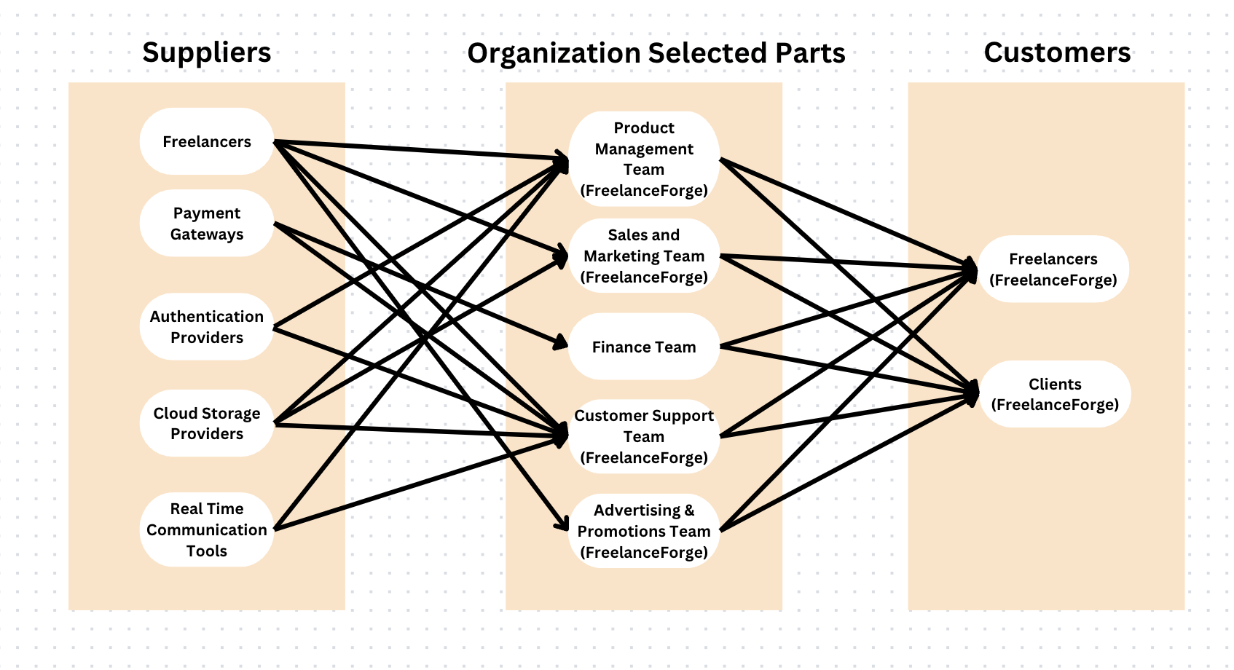
Freelance Forge: Business Relationship Map

Slide 2
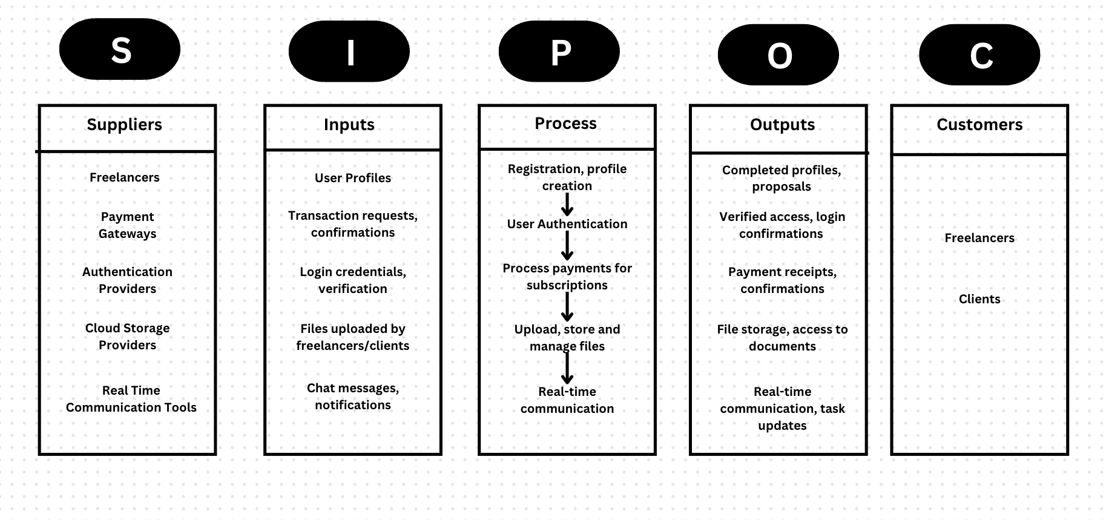
Freelance Forge: SIPOC Diagram

Slide 3
User Role By Business Group
External Users (Customers)
Client - Sai Aneesh Freelancer - Asritha Pallapotu
Business Group | User Roles | Team Member Name (Bus. Group Proxy)
Product Management Team | Manager, Product Manager | Syed Adnan, Akhil Yadati
Sales and Marketing Team | Sales Representative, Digital Marketer | Amar Gopal Kapalavai, Venkata Puneeth Nannapaneni
Customer Support Team | Technical Support Specialist, Support Agent | Jensikumari Ishvarbhai Jasoliya, Sai Aneesh
Advertising & Promotions Team | Social media Manager, SEO Specialist | Dhvani Borda, Yugantkumar Gajera

